Slide 1
Clean Up Your Code: 10 Java Coding Tricks, Techniques, & Philosophies
Neal Ford
Architect
ThoughtWorks
www.nealford.com
www.thoughtworks.com
nford@thoughtworks.com
memeagora.blogspot.com

Slide 2
Questions, Slides, and Samples
Please feel free to ask questions anytime
The slides and samples will be available at www.nealford.com
I’ll show that address again at the end

Slide 3
What This Session Covers:
Names of Things
Composed Method
Apply the Unix Philosophies
Syntactic Stuff
Orthogonality
Compactness
The Pragmatic Rules
Template Method
Bad Inheritance
Decoupling with Interfaces

Slide 4
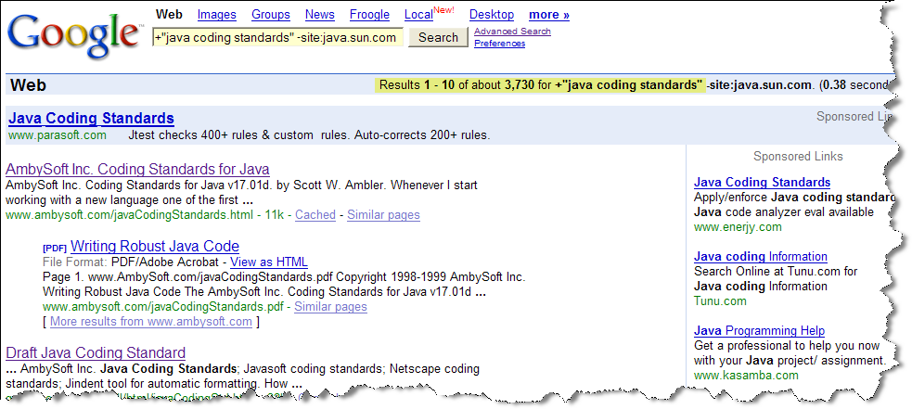
#1. Names of Things
Need a Java Coding Standard? Take your pick

Slide 5
#1. Names of Things
Variable naming conventions
  The Document
  Heuristics
  Hungarian notation
    Useful for loosely typed, loosely scoped languages
    Shouldn’t be needed for Java
    The problem:
      It ties the type too intimately to the variable
      Types are abstractions

Slide 6
Names of Things
My solution: make readable variable names
Length and readability is tied to scope
  Member variables have long, descriptive names
  The tighter the scope, the shorter the name
    Local variables in private methods have terse names
      Small methods prevent searching for short variable names
      Becomes a problem when you have really long private methods (remedied in Tip #2)
    Public methods should have longer names because they are more likely to be read

Slide 7
General Coding Conventions
Back in the dark ages (2-3 years ago), coding standards were enforced manually
Tools now handle it
IDE’s
  Eclipse
  JBuilder
  IntelliJ
Standalone
  AStyle
  Jalopy

Slide 8
The Company Standard
Doesn’t have to impact day-to-day coding
Use a company standard for the final (versioned) source
Use tools to reformat code to your liking for daily coding
Part of a build cycle
  Use Ant to get code and reformat it using tool
  Work on it
  Use Ant to check it back in, applying formatting in the process
Everyone’s happy!

Slide 9
#2. Composed Method
Two types of comments exist
  Documentation (JavaDoc) comments
  Intra-code comments
I like Documentation comments
I don’t like intra-code comments
  No one ever reads them
  They smell
  They lie!
How do you live without them?

Slide 10
Composed Method
Composed method (originally in Smalltalk Best Practice Patterns by Kent Beck)
Method names are long, readable descriptions of what the method does
Every method is as discrete as possible
  No method longer than 15 lines of code
    Some limit this to 5!
  All public methods read as outlines of tasks, implemented as private methods
Example: applying composed method
Example: applying inheritance
Notes:
Before:
public class PartDb {
private static final String DRIVER_CLASS = "com.mysql.jdbc.Driver";
private static final String DB_URL = "jdbc:mysql://localhost/orderentry2002";
private static final int DEFAULT_INITIAL_LIST_SIZE = 40;
private static final String SQL_SELECT_PARTS =
"select name, brand, retail_price from parts";
private static final Part[] TEMPLATE = new Part[0];
private ArrayList partList;
private static final String USER = "webuser";
private static final String PASSWORD = "webpass";
public PartDb() {
partList = new ArrayList(DEFAULT_INITIAL_LIST_SIZE);
}
public void populate() throws Exception {
Connection c = null;
try {
Class.forName(DRIVER_CLASS);
c = DriverManager.getConnection(DB_URL, USER, PASSWORD);
Statement stmt = c.createStatement();
ResultSet rs = stmt.executeQuery(SQL_SELECT_PARTS);
while (rs.next()) {
Part p = new Part();
p.setName(rs.getString("name"));
p.setBrand(rs.getString("brand"));
p.setRetailPrice(rs.getDouble("retail_price"));
partList.add(p);
}
} finally {
c.close();
}
}
public Part[] getParts() {
return (Part []) partList.toArray(TEMPLATE);
}
}

Slide 11
Composed Method
Four benefits of composed method
  Stack traces are easier to read
  Debugging is easier
  Makes writing unit tests easier
  Makes it much easier to identify methods generic enough to push up the inheritance hierarchy
Notes:
public class PartDb {
private static final String DRIVER_CLASS = "com.mysql.jdbc.Driver";
private static final String DB_URL = "jdbc:mysql://localhost/orderentry2002";
private static final int DEFAULT_INITIAL_LIST_SIZE = 40;
private static final String SQL_SELECT_PARTS = "select name, brand, retail_price from parts";
private static final Part[] TEMPLATE = new Part[0];
private ArrayList partList;
public PartDb() {
partList = new ArrayList(DEFAULT_INITIAL_LIST_SIZE);
}
public void populate() throws Exception {
Connection c = null;
try {
c = getDatabaseConnection();
ResultSet rs = createResultSet(c);
while (rs.next())
addPartToListFromResultSet(rs);
} finally {
c.close();
}
}
public Part[] getParts() {
return (Part[]) partList.toArray(TEMPLATE);
}
private ResultSet createResultSet(Connection c) throws SQLException {
Statement stmt = c.createStatement();
ResultSet rs = stmt.executeQuery(SQL_SELECT_PARTS);
return rs;
}
private Connection getDatabaseConnection() throws ClassNotFoundException, SQLException {
Connection c;
Class.forName(DRIVER_CLASS);
c = DriverManager.getConnection(DB_URL, "webuser", "webpass");
return c;
}
private void addPartToListFromResultSet(ResultSet rs) throws SQLException {
Part p = new Part();
p.setName(rs.getString("name"));
p.setBrand(rs.getString("brand"));
p.setRetailPrice(rs.getDouble("retail_price"));
partList.add(p);
}

Slide 12
#3. Apply the Unix Philosophies
From The Art of Unix Programming:
1. Rule of Modularity
  Write simple parts connected by clean interfaces.
2. Rule of Clarity
  Clarity is better than cleverness.
3. Rule of Composition
  Design programs to be connected to other programs.
4. Rule of Separation
  Separate policy from mechanism; separate interfaces from engines.

Slide 13
The Unix Philosophies
5. Rule of Simplicity
  Design for simplicity; add complexity only where you must
6. Rule of Parsimony
  Write a big program only when it is clear by demonstration that nothing else will do.
7. Rule of Transparency
  Design for visibility to make inspection and debugging easier
8. Rule of Robustness
  Robustness is the child of transparency and simplicity

Slide 14
The Unix Philosophies
9. Rule of Representation
  Fold knowledge into data so program logic can be stupid and robust
10. Rule of Least Surprise
  In interface design, always do the least surprising thing
11. Rule of Silence
  When a program has nothing surprising to say, it should say nothing
12. Rule of Repair
  When you must fail, fail noisily and as soon as possible

Slide 15
The Unix Philosophies
13. Rule of Economy
  Programmer time is expensive; conserve it in preference to machine time.
14. Rule of Generation
  Avoid hand-hacking; write programs to write programs when you can.
15. Rule of Optimization
  Prototype before polishing. Get it working before you optimize it.

Slide 16
Optimization
  Rules of Optimization:
  Rule 1: Don't do it.
  Rule 2 (for experts only): Don't do it yet.
  M.A. Jackson
  More computing sins are committed in the name of efficiency (without necessarily achieving it) than for any other single reason - including blind stupidity.
  W.A. Wulf
  We should forget about small efficiencies, say about 97% of the time: premature optimization is the root of all evil.
  Donald Knuth
  The best is the enemy of the good.
  Voltaire

Slide 17
The Unix Philosophies
16. Rule of Diversity
  Distrust all claims for “one true way”.
17. Rule of Extensibility
  Design for the future, because it will be here sooner than you think.

Slide 18
#4. Syntactic Stuff: Constants
You can create constants 2 ways:
  In a class
  In an interface
If the constants are tied to a particular class, they should be within the class
  Example: Calendar and the field constants
If the constants stand alone and need no other infrastructure, they could be placed in an interface
  Allows for fewer keywords with same end result

Slide 19
Handling Constants
Be sure not to access the constants by implementing the interface!
  This makes the constants part of the signature for the class, which is frowned upon
Access the constants through the name of the interface
Static imports in J2SE 5 make this easier because you don’t have to fully qualify the names (although you generally should for clarity)
Example: static imports in Java 5
Notes:
public interface OrderEntryConstants {
final String DRIVER_CLASS = "com.mysql.jdbc.Driver";
final String DB_URL = "jdbc:mysql://localhost/orderentry2002";
final String USER = "webuser";
final String PASSWORD = "webpass";
}
import static com.nealford.conf.nfjs.cleanup.OrderEntryConstants.*;
import java.sql.*;
abstract public class BoundaryBase {
protected Connection getDatabaseConnection() throws ClassNotFoundException,
SQLException {
Connection c;
Class.forName(DRIVER_CLASS);
c = DriverManager.getConnection(DB_URL, USER, PASSWORD);
return c;
}
. . .

Slide 20
Syntactic Stuff: Enumerations
The problem: Until 5, Java didn’t have a native enumeration type
Enumerations are typically implemented as integer constants
  No range checking
  Adding constants without re-compiling leads to unpredictable behavior
  Meanings are too tightly tied to integer values
    Example: the Calendar class and months

Slide 21
Typesafe Enum Pattern
The typesafe enum pattern appears in Effective Java by Joshua Bloch
To implement:
  Define a class representing a single element of the enumerated type
  Don’t provide any public constructors
  Provide public static fields, one for each constant
Notes:
public class Suit {
public static final Suit CLUBS = new Suit("clubs");
public static final Suit DIAMONDS = new Suit("diamonds");
public static final Suit HEARTS = new Suit("hearts");
public static final Suit SPADES = new Suit("spades");
private final String name;
private Suit(String name) {
this.name = name;
}
public String toString() {
return name;
}
}

Slide 22
Typesafe Enum Pattern
Java now includes EnumSyntax class
  Base class to make it easy to implement Type-safe Enum pattern
  Since ???
  Example
Not needed in Java 5
Enumerations become part of the language
Example
Notes:
public class Bach extends EnumSyntax {
public static final Bach JOHANN_SEBASTIAN = new Bach(0);
public static final Bach WILHELM_FRIEDEMANN = new Bach(1);
public static final Bach CARL_PHILIP_EMMANUEL = new Bach(2);
public static final Bach JOHANN_CHRISTIAN = new Bach(3);
public static final Bach P_D_Q = new Bach(4);
private static final String[] stringTable = {
"Johann Sebastian Bach",
"Wilhelm Friedemann Bach",
"Carl Philip Emmanuel Bach",
"Johann Christian Bach",
"P.D.Q. Bach"
};
private Bach(int id) {
super(id);
}
protected String[] getStringTable() {
return stringTable;
}
private static final Bach[] enumValueTable = {
JOHANN_SEBASTIAN,
WILHELM_FRIEDEMANN,
CARL_PHILIP_EMMANUEL,
JOHANN_CHRISTIAN,
P_D_Q
};
protected EnumSyntax[] getEnumValueTable() {
return enumValueTable;
}
enum CardSuit {
CLUB, HEART, DIAMOND, SPADE
};
public class Suit5 {
public Suit5() {
for (CardSuit s : CardSuit.values())
System.out.println(s);
}
public static void main(String[] args) {
new Suit5();
}
}

Slide 23
equals()
According to J2SE, the equals() method must be:
  Reflexive
  Symmetric
  Transitive
  Consistent
  Non-null reference value

Slide 24
Recipe for the Perfect equals()
Use == to check to see if you have been passed a direct reference to yourself.
Use the instanceof operator or getClass() to check the lineage of the object.
Cast the object to the correct type.
Check the equality of each field of the class. If any test fails, return false. Note that this will turn around and call the equals() method of the non-primitive fields of you class, so this can be time consuming. This should be done last after all the other (faster) tests have been passed.
Make sure that your equals() is symmetric, transitive, and consistent.

Slide 25
Hash Data Structures
What is a Map (Hashtable or HashMap)?
  Dictionary data structure for fast lookups of items
  Consists of a configurable number of buckets
    Each bucket corresponds to a hash value
    Each bucket serves as the root of a linked list

Slide 26
Hashing
1
return length;
“Hello”
2
“Hi”
“Java”
3
“object”
4
“Java”
“Hi”
5
“Hello”
“World”
“Sydney”
6
“object”
“Sydney”
“World”
7

Slide 27
hashCode()
Any time you override equals(), you should also override hashCode()
Rules (from J2SE)
  When invoked on the same object, it must return the same value
  If two objects are equal, they must return the same hashCode
  It is not required that two unequal objects return different hashCodes, but Collections performance will suffer
Example: hashCode

Slide 28
Recipe for a Perfect hashCode()
Store a constant (prime) number in a variable
For each field in the class that contributes to equals(), calculate a value for the field and add it to the result multiplied by a nontrivial prime number
Return the result

Slide 29
#5: Orthogonality
Orthogonal
  From Merriam-Webster:
    1 a : intersecting or lying at right angles b : having perpendicular slopes or tangents at the point of intersection <orthogonal curves>
  From Art of Unix Programming:
    “In a purely orthogonal design, operations do not have side effects; each action (whether it’s an API call, a macro invocation, or a language operation) changes just one thing without affecting others. There is one and only one way to change each property of whatever system you are controlling.”

Slide 30
Orthogonality
Concrete example: Command-query separation
  Creating an accessor that performs some work (i.e., a side effect)
    public int getValue() {
    myValue *= SOME_OTHER_CONST;
    return myValue;
    }
Static analysis tools catch this
  TogetherJ
  PMD
Notes:
“Wiring up” PMD with IntelliJ
There's not a "real" - i.e., integrated into the same Java VM - plugin for IDEA, but using it as an IDEA "External Tool" works OK. Here's how to set it up:
Open IDEA and go to File->Settings
Click on the "External Tools" icon
Click on the Add button
Fill in the blocks
Name: PMD
Description: PMD doth help one clean the code
Program: javaw
For the next two parameters you'll need to plug in the location of your PMD installation, the rulesets you want to use, and your working directory
Parameters: -cp %CLASSPATH%;c:\pmd\lib\pmd-2.3.jar;c:\pmd\lib\jaxen-core-1.0-fcs.jar;c:\pmd\lib\saxpath-1.0-fcs.jar net.sourceforge.pmd.PMD $FilePath$ ideaj rulesets/unusedcode.xml,rulesets/imports.xml $Sourcepath$ $FileClass$.method $FileName$
Working directory: c:\
That's pretty much it. Now you can right click on a source directory and select PMD, it'll run recursively on the source files, and the results should be displayed in a window and hyperlinked into the correct file and line of code. I usually right-click on the message window title bar and unselect "autohide" so the window doesn't go away every time I fix something in the code window.

Slide 31
Orthogonality
Another example: a Stack class
Traditionally, Stack’s have a pop() method that does 2 things:
  Removes the top value
  Returns the top value
A more orthogonal approach has 2 methods:
  Object top()
  void removeTop()
Simplifies (or makes possible)
  Concurrency control
  Subclass-based extensions

Slide 32
#6. Compactness
Can a design fit inside a human’s head?
Does an experienced user normally need a manual?
Compactness is a measure of discrete parts and complexity
Why are US phone numbers 7 digits?
  The Magical Number Seven, Plus or Minus Two: Some Limits on Our Capacity for Processing Information George Miller
Notes:
The Magical Number Seven, Plus or Minus Two: Some Limits on Our Capacity for Processing Information George Miller
http://www.well.com/user/smalin/miller.html

Slide 33
Compactness
Compact is not equivalent to weak
A design can have a great deal of power and flexibility and still be compact
Example: QuickSort
Compact also does not imply “easy to learn”
Some compact designs are quite difficult to understand until you have mastered the conceptual model
  VI, Haskell, SML
Notes:
public class QuickSort implements SortedArrayList.Sorter {
private void quickSort(ArrayList list, int low0, int high0) {
int low = low0, high = high0;
if (low >= high) {
return;
} else if (low == high - 1) {
if (((Comparable)list.get(low)).compareTo(list.get(high)) > 0) {
Object temp = list.get(low);
list.set(low, list.get(high));
list.set(high, temp);
}
return;
}
Object pivot = list.get((low + high) / 2);
list.set((low + high) / 2, list.get(high));
list.set(high, pivot);
while (low < high) {
while (((Comparable)list.get(low)).compareTo(pivot) <= 0
&& low < high) {
low++;
}
while (((Comparable)list.get(high)).compareTo(pivot) >= 0
&& low < high) {
high--;
}
if (low < high) {
Object temp = list.get(low);
list.set(low, list.get(high));
list.set(high, temp);
}
}
list.set(high0, list.get(high));
list.set(high, pivot);
quickSort(list, low0, low - 1);
quickSort(list, high + 1, high0);
}
public void sort(ArrayList list) {
quickSort(list, 0, list.size() - 1);
}
}

Slide 34
Compactness
Raymond and I classify tools and languages
  Compact
    Make, VI, Ant
  Semi-compact
    HTML, C, Python, Ruby, Lisp
  Not Compact
    Perl, Java, Emacs
  Anti-compact
    C++
You may have heard Ruby fanatics talk about “the principle of least surprise”

Slide 35
#7. The Pragmatic Rules
From The Pragmatic Programmer
  Don’t live with broken windows
  DRY – Don’t Repeat Yourself
From Agile Best Practices
  YAGNI – You Ain’t Gonna Need It
  Embrace changing requirements by
    Refactor mercilessly
    Unit testing everything

Slide 36
Refactor Mercilessly
Tool support
  JBuilder
  IntelliJ
  Eclipse
Set aside a time period every day to refactor code
Refactoring is fun, and is different from “regular” coding
How can you have the confidence when making changes to code that you aren’t going to break something with a side effect?

Slide 37
Unit Test Everything
Unit testing is a frame of mind, not a tool set
Doesn’t really matter if you write the tests first, as long as the tests and the code are written close together
Applications grow from the bottom up, with small little units of verified code
Strategies and algorithms appear that you wouldn’t consider before
  See Robert Martin’s column in Software Development Magazine
  http://www.sdmagazine.com/columnists/martin/

Slide 38
#8. Template Method Design Pattern
From the Gang of Four book:
  “Define the skeleton of an algorithm in an operation, deferring some steps to subclasses. Template Method lets subclasses redefine certain steps of an algorithm without changing the algorithm’s structure.”
Encourages you to define the general order of operations for some process in an abstract parent, then implement the details in child classes.

Slide 39
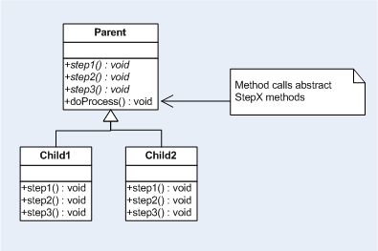
Template Method Design Pattern

Slide 40
Template Method Design Pattern
Works best when your code consists of very cohesive, discrete methods (See tip #2, Composed Method)
Allows you to define business processes that are immutable at a high level and defer the steps to child classes.
You should aggressively pull methods up the hierarchy and look for definable processes
Example

Slide 41
Another Common Example of Template
Consider the CallSuper anti-pattern
Appears when a framework insists that you remember to call it’s super class method when you override a framework method
public class EventHandler ...
public void handle (BankingEvent e) {
housekeeping(e);
}
public class TransferEventHandler extends EventHandler...
public void handle(BankingEvent e) {
super.handle(e);
initiateTransfer(e);
}

Slide 42
The Problem: Remembering
Any framework that forces you to remember stuff like this has a code smell
The better version uses Template Method to create a hook method
public class EventHandler ...
public void handle (BankingEvent e) {
housekeeping(e);
doHandle(e);
}
protected void doHandle(BankingEvent e) {
}
public class TransferEventHandler extends EventHandler ...
protected void doHandle(BankingEvent e) {
initiateTransfer(e);
}

Slide 43
#9. Bad Inheritance
Implementation inheritance leads to problems in certain situations
Example: A set sub-class
Inheritance sometimes breaks encapsulation
Superclasses can acquire new methods in subsequent releases. This either
  Breaks the child
  Inadvertently overrides the new method
Notes:
public class InstrumentedList : ArrayList {
private int addCount = 0;
public override int Add(Object o) {
addCount++;
return base.Add(o);
}
public override void AddRange(ICollection c) {
addCount += c.Count;
base.AddRange(c);
}
public int AddCount {
get {
return addCount;
}
}
}

Slide 44
Bad Inheritance
Use composition instead of inheritance
  Encapsulate the type you were going to override and “forward” method calls to it
  This is a flavor of the Decorator Design Pattern
This is possible if you have an interface that defines the semantics of type
Inheritance is only applicable when the child “is-a” type of parent in every case
Java Platform breaks this rule often
  A Stack is not a Vector
  A property list isn’t a hash table
Notes:
public class InstrumentedHashSetTest extends TestCase {
private String[] testList = new String[] {"Homer", "Bart", "Lisa"};
private InstrumentedHashSet hashSet;
protected void setUp() throws Exception {
super.setUp();
hashSet = new InstrumentedHashSet();
}
protected void tearDown() throws Exception {
hashSet = null;
super.tearDown();
}
public void testAdd() {
for (String s : testList)
hashSet.add(s);
for (String s : testList)
assertTrue("Item not in list", hashSet.contains(s));
}
public void testAddAll() {
hashSet.addAll(Arrays.asList(testList));
for (String s : testList)
assertTrue("Item not in list", hashSet.contains(s));
assertEquals("Wrong size", testList.length, hashSet.getAddCount() );
}
}

Slide 45
#10. Use Interfaces for Decoupling
Whenever possible, define types and member variables as interfaces
  For member variables that are collections
  For flexibility in types
  To interface with frameworks

Slide 46
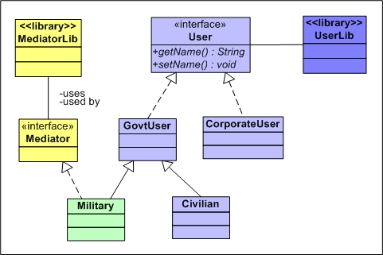
Use Interfaces for Decoupling

Slide 47
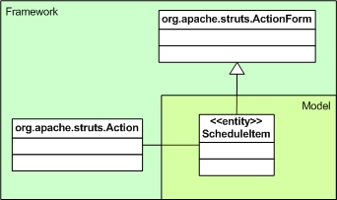
Use Interfaces for Decoupling
Collections
  Use List instead of ArrayList in declarations
Example from Struts and ActionForms
  Don’t extend ActionForm in your entities

Slide 48
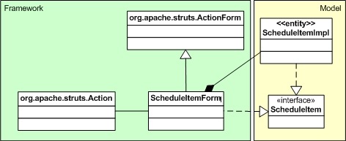
Struts and Interfaces
Recipe for decoupling from frameworks
  Create a domain interface
  Create a concrete entity class that implements the interface
  Create an ActionForm that implements the interface

Slide 49
What’s the End Result of Cleaning Up Your Code?
Compare the first version to the second…
You are left with 2 types of code:
  Framework
  Configuration
Notice that this is the motivating factor behind containers (like Spring)
  Put the framework code in a generic place (the common things that everyone needs to do)
  Put the configuration code somewhere else
    In another class
    In another language? (maybe XML?)
The cleanup exercise exposes different types of code
Allows you to refactor it even more…into DSL???

Slide 50
Summary
Leverage granularity
  Use composed method, template method, unit testing, and refactoring to build small, tested units of work
  Build large things from small things
The Homer Simpson effect
  Just because you can do something doesn’t mean you should do it
  Don’t be too clever (remember the bus!)
Live on the boundary of compactness and orthogonality vs. cleverness
Code is the most important artifact you create

Slide 51
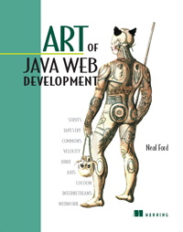




For More Information
Art of Java Web Development
  Neal Ford
Refactoring
  Martin Fowler
Effective Java
  Joshua Bloch
Pragmatic Programming
  Andrew Hunt & David Thomas
Art of Unix Programming
  Eric Raymond
Object Orientation Tips
  www.ootips.org

Slide 52
Questions?
Samples & slides at www.nealford.com
Neal Ford
www.nealford.com
nford@thoughtworks.com
memeagora.blogspot.com
This work is licensed under a Creative Commons Attribution-NonCommercial-ShareAlike 2.5 license. http://creativecommons.org/licenses/by-nc-sa/2.5/

